Slide 1
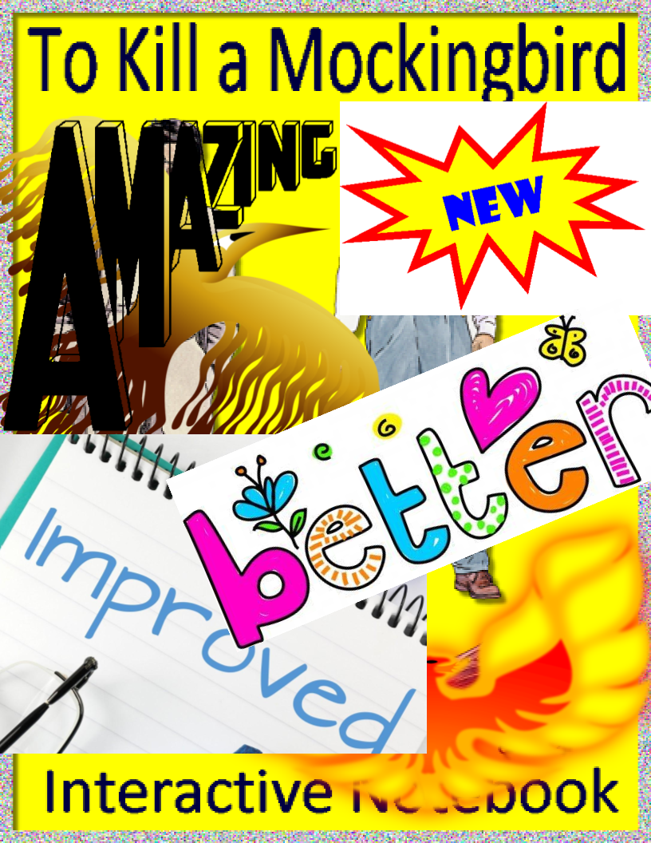

Slide 2
When I first assigned this digital notebook, which I did in order to help students do well on the chapter comprehension tests, I scaffolded the assignments using the Promethean. Since then, I've added scaffolding directly to the digital notebook, but I'm still posting this collection of original scaffolding to provide alternatives and because some students might find it more helpful than the scaffolding that's been added directly to the digital notebook. -Mr. A

Slide 3
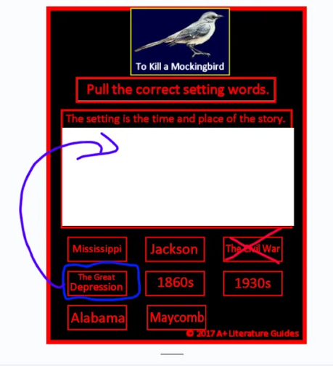

Slide 4
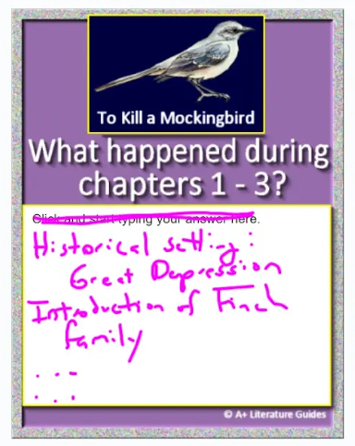

Slide 5
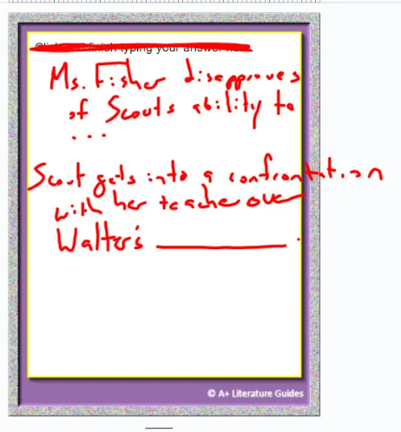

Slide 6
